Slide 1
Delivery Management System
B489059 이현식
B489060 이혜리
B584030 이나영
B589021 박수빈
교수님 면담 11월 8일

Slide 2
Index
001/ MOTIVATION
002/ MEMBERS FOR THIS PROJECT
003/ REQUIREMENT SPECIFICATION
004/ ER - DIAGRAM
005/ HOMEPAGE UI, MOBILE UI
006/ PROBLEM
007/ DATABASE SYSTEM STRUCTURE
008/ SIMULATION VIDEO
009/ CONCULUSION

Slide 3
1
MOTIVATION
“
We wanted to implement a system which is possible that consumers can rewrite delivery location and order information.
We felt uncomfortable about slow delivery. So we use a free courier service so that customers can get shipped as soon as possible.
”

Slide 4
2
MEMBERS FOR THIS PROJECT
The roles of members for this project
Lee Na Young
: order inquiry page UI, php connection
& related database setting
Lee Hyun Sik
: order page UI & php connection
25%
25%
25%
25%
Lee Hye Ri
: order modification and delete page UI
& php connection
Park Soo bin
: Initial screen and order page UI
& php connection

Slide 5
3
REQUIREMENT SPECIFICATION
Order can not be modified and canceled during shipment.
All input values can only be entered in English.
Can not modify buyer's phone number.
The quantity of products can be changed, but the product
can not be modified.

Slide 6
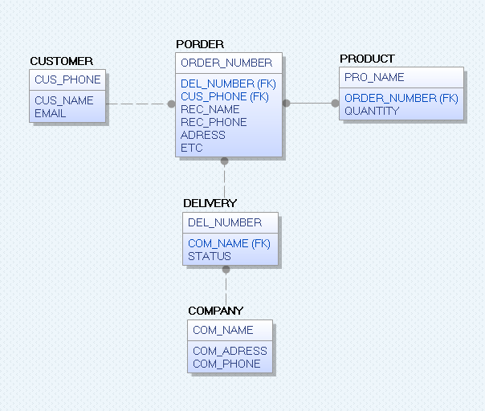
4
ER - Diagram
1 : n
m : n
1 : 1
n
..
1

Slide 7
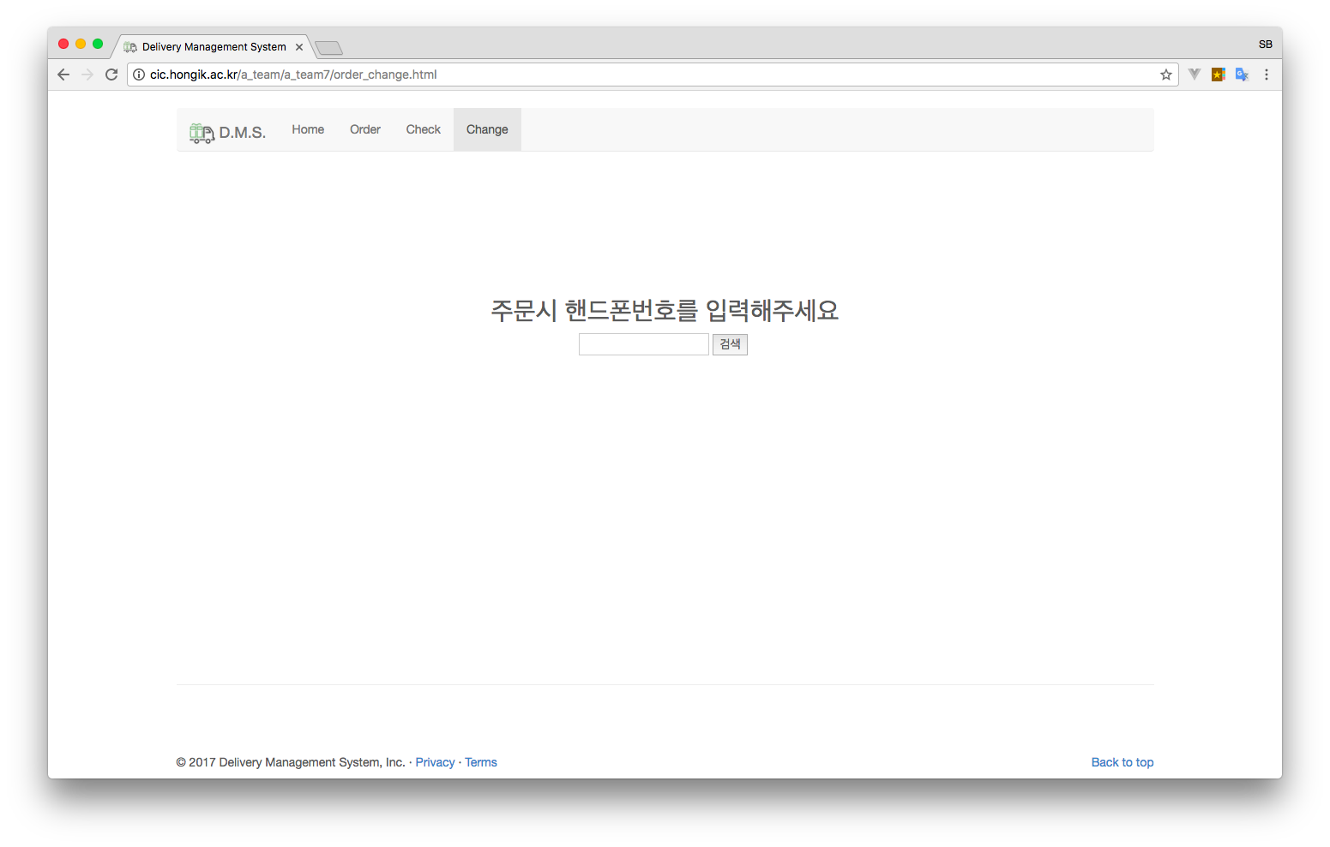
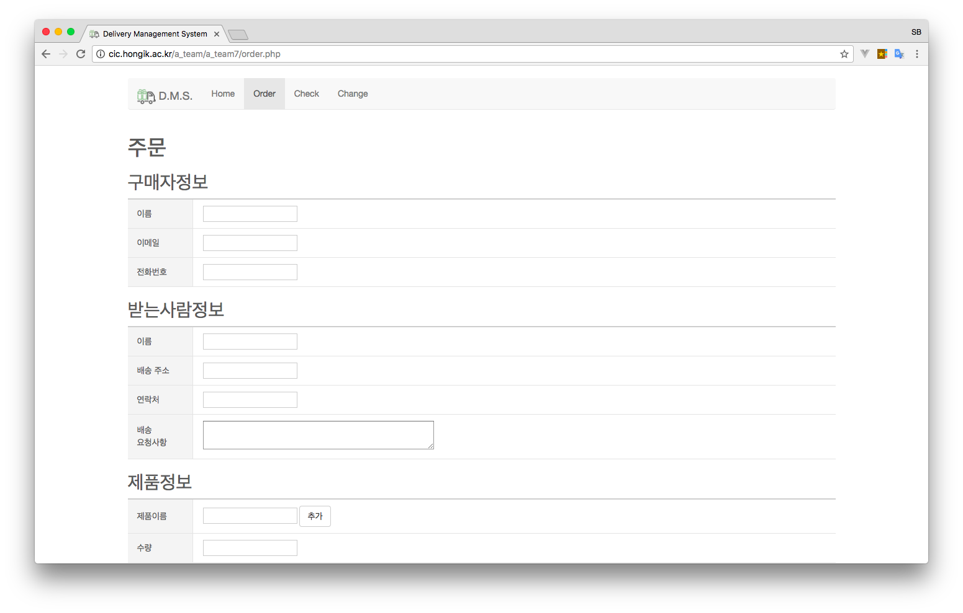
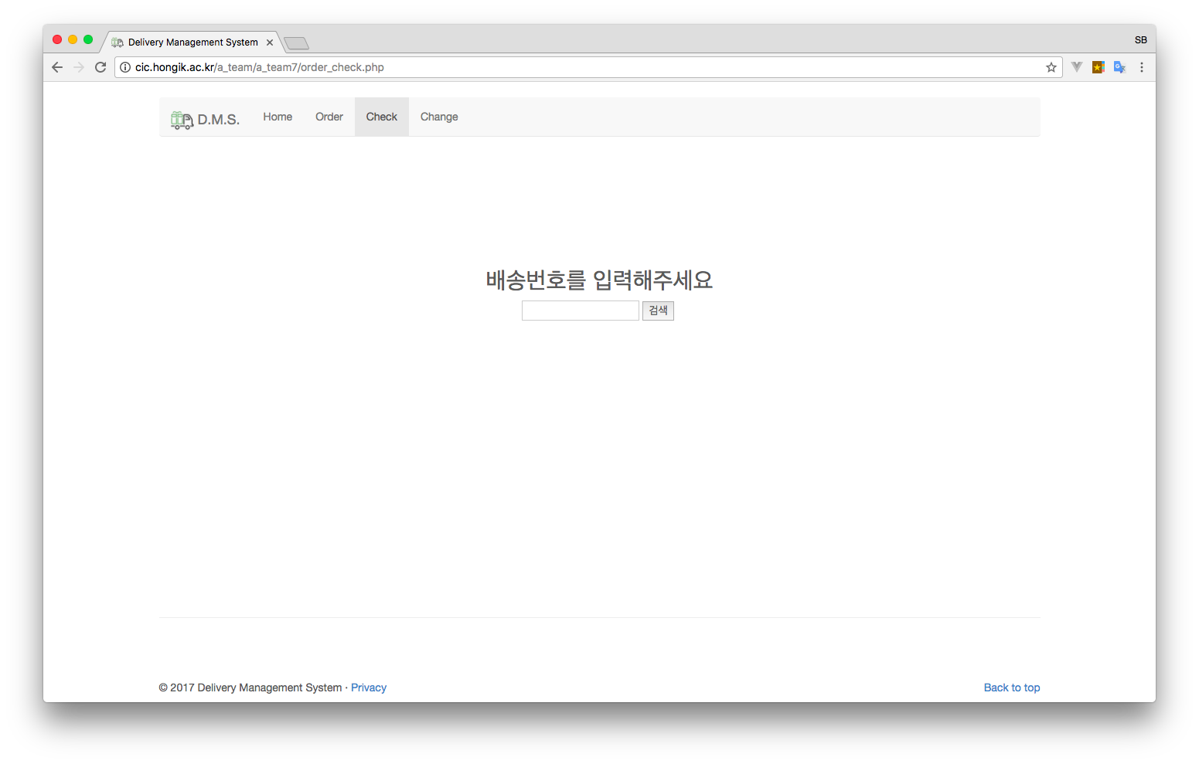
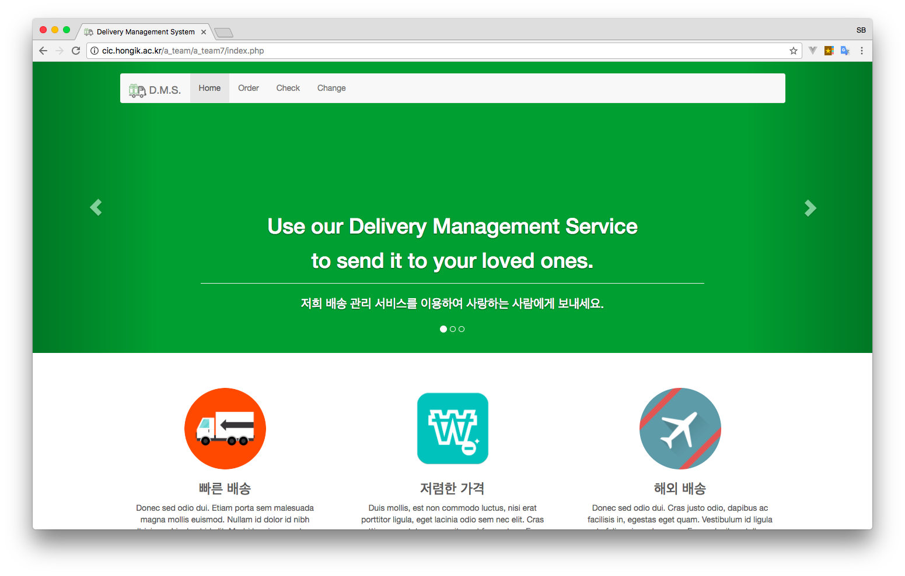
5
HOME UI

Slide 8
5
ORDER UI

Slide 9
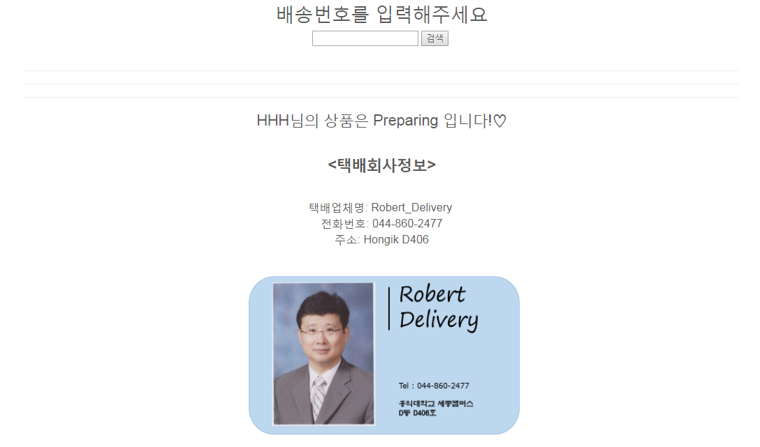
5
CHECK UI

Slide 10
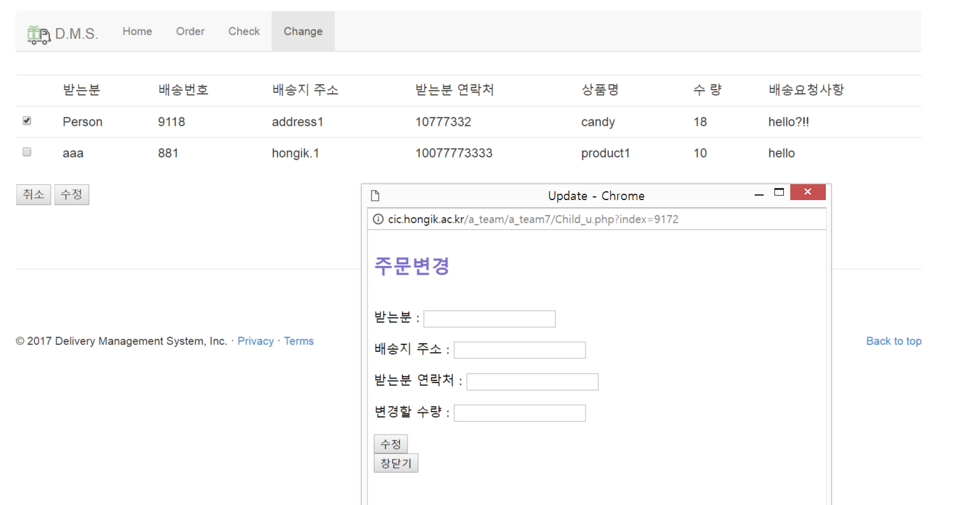

5
CHANGE UI

Slide 11
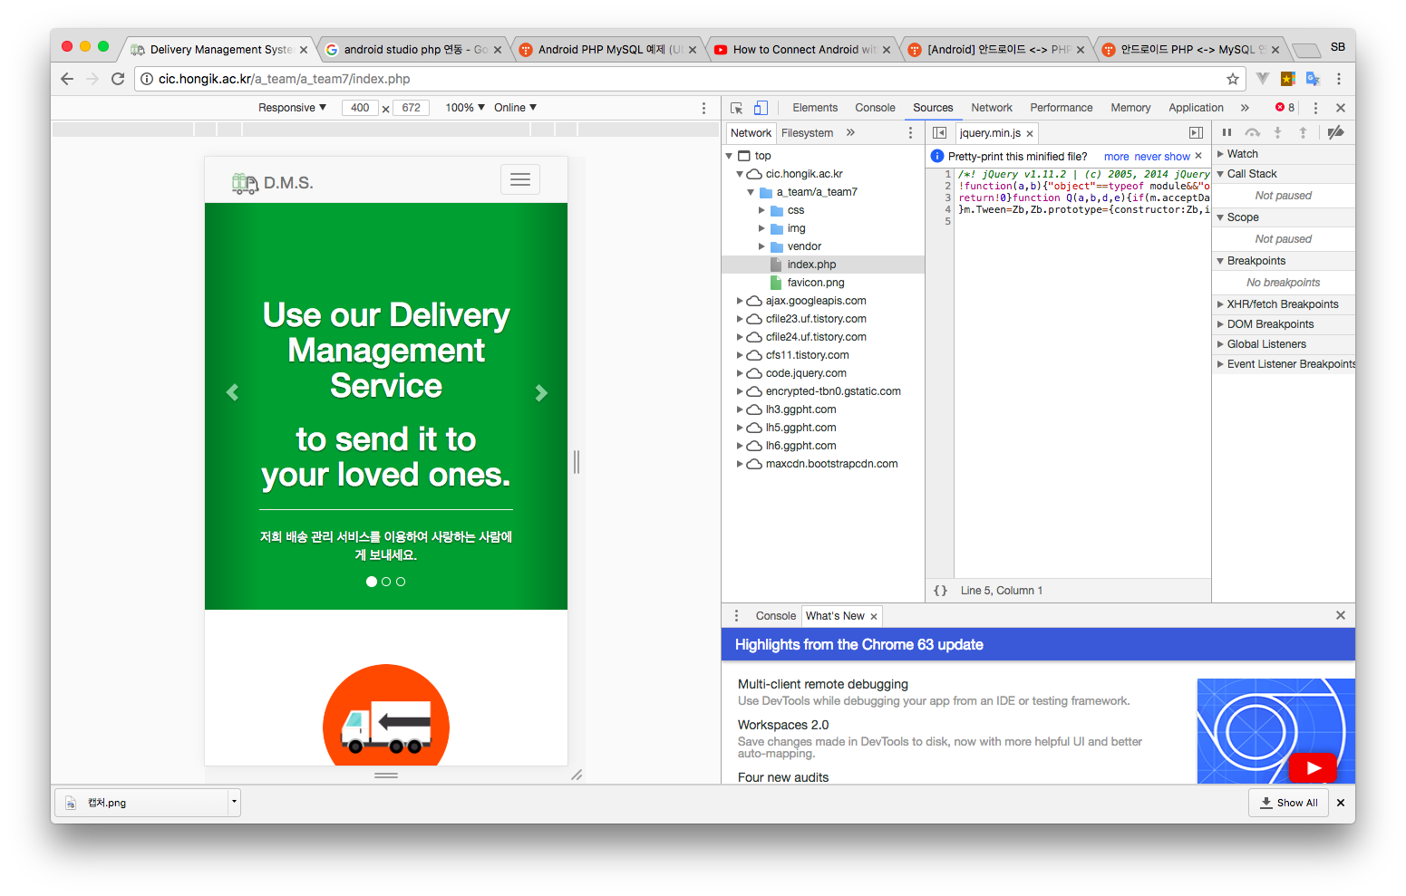
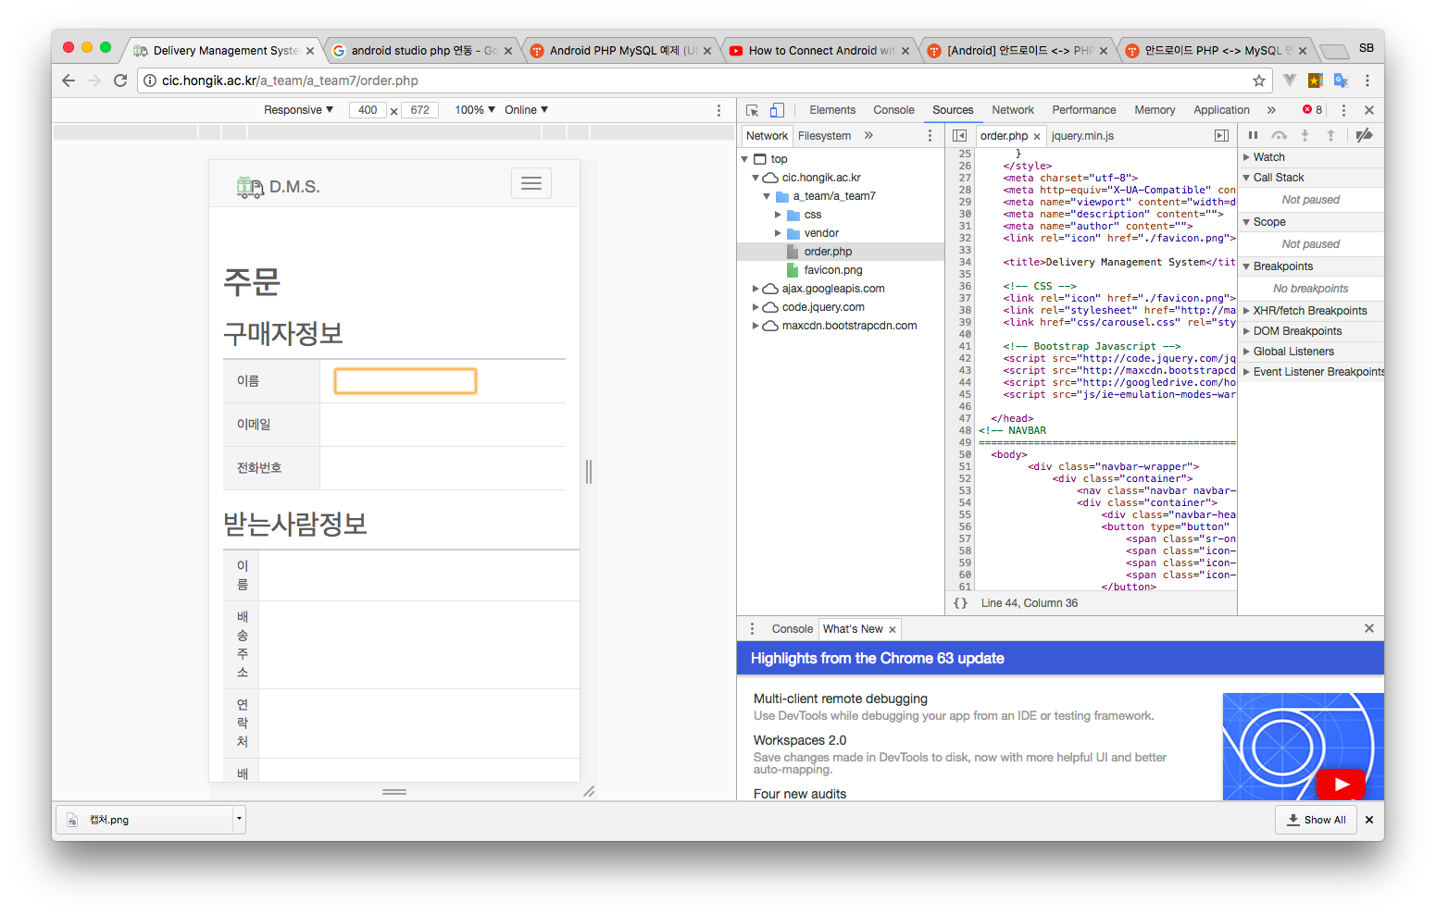
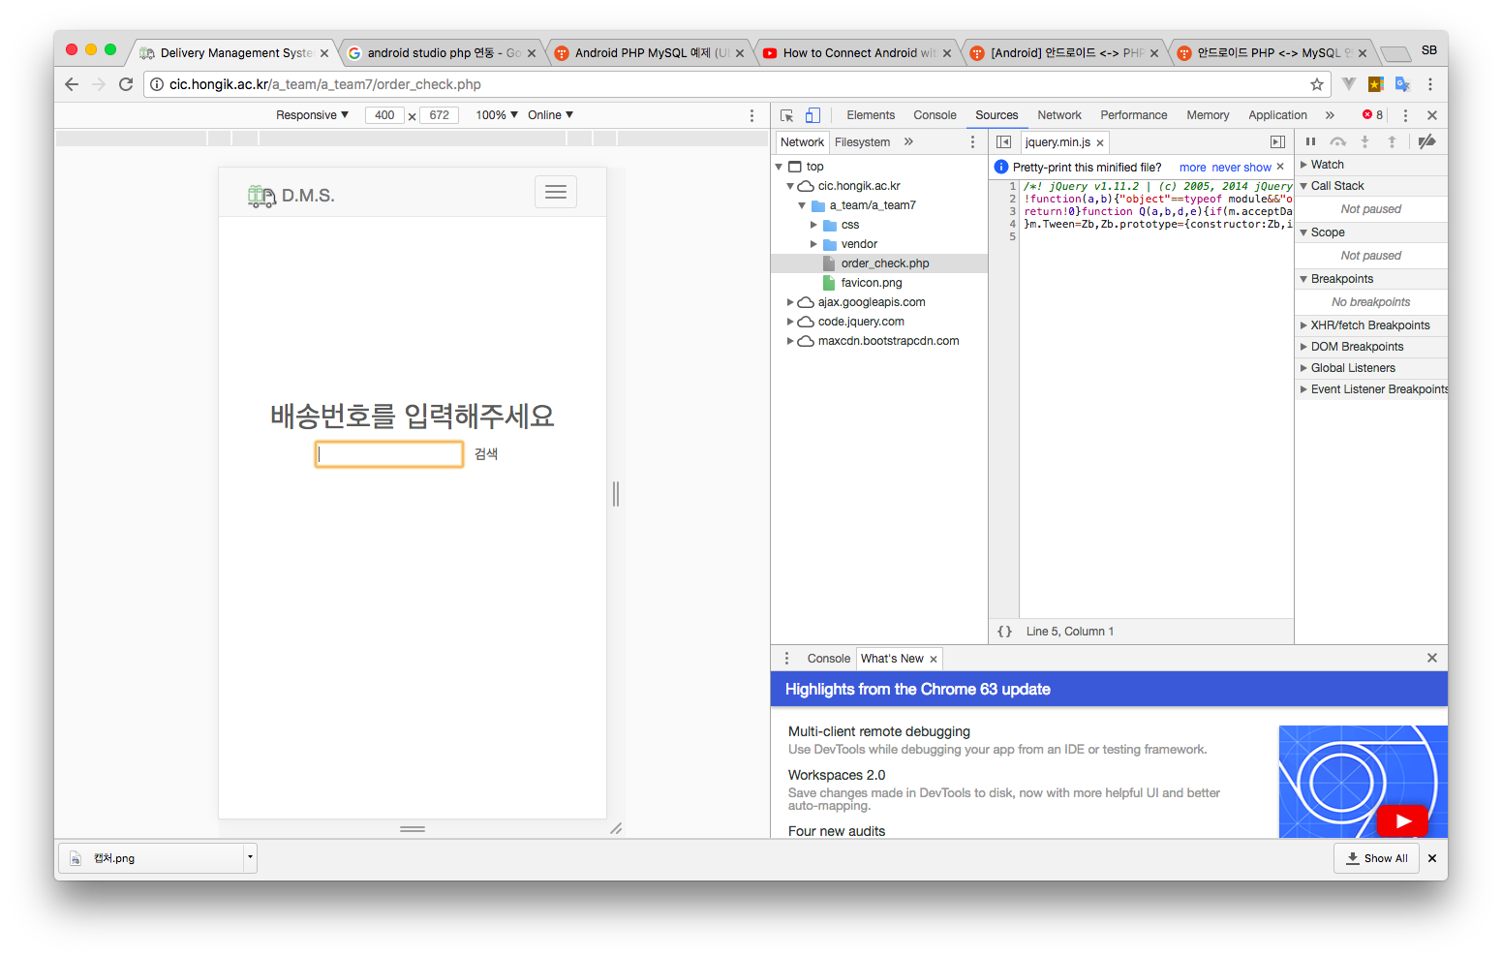
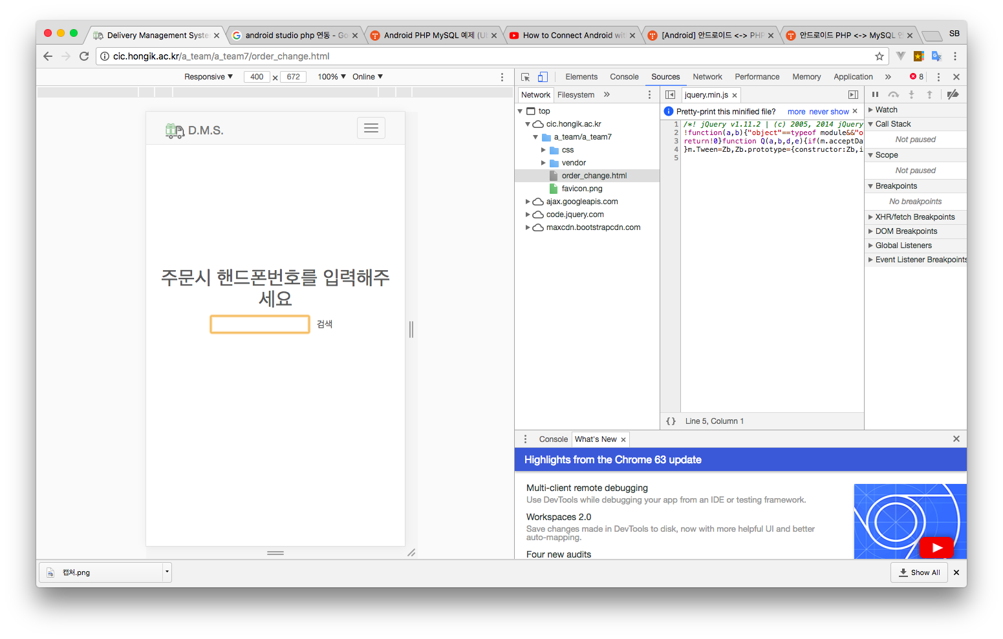
5
MOBILE UI

Slide 12
6
PROBLEM
회원가입 기능이 없어 고객관리에 문제
SQL에서 동시 접속 했을 때 저장이 안 된 상태에서 나가면 입력값이 날아감
안드로이드 연동 문제

Slide 13
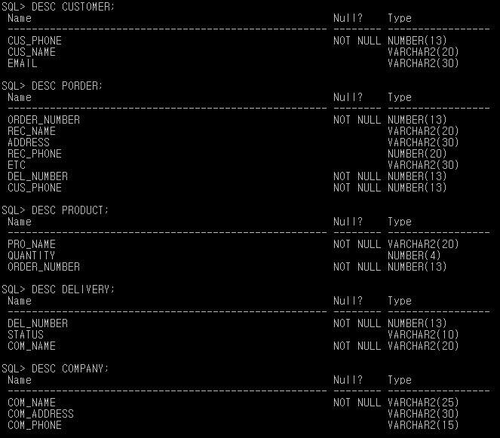
7
DATABASE SYSTEM STRUCTURE

Slide 14
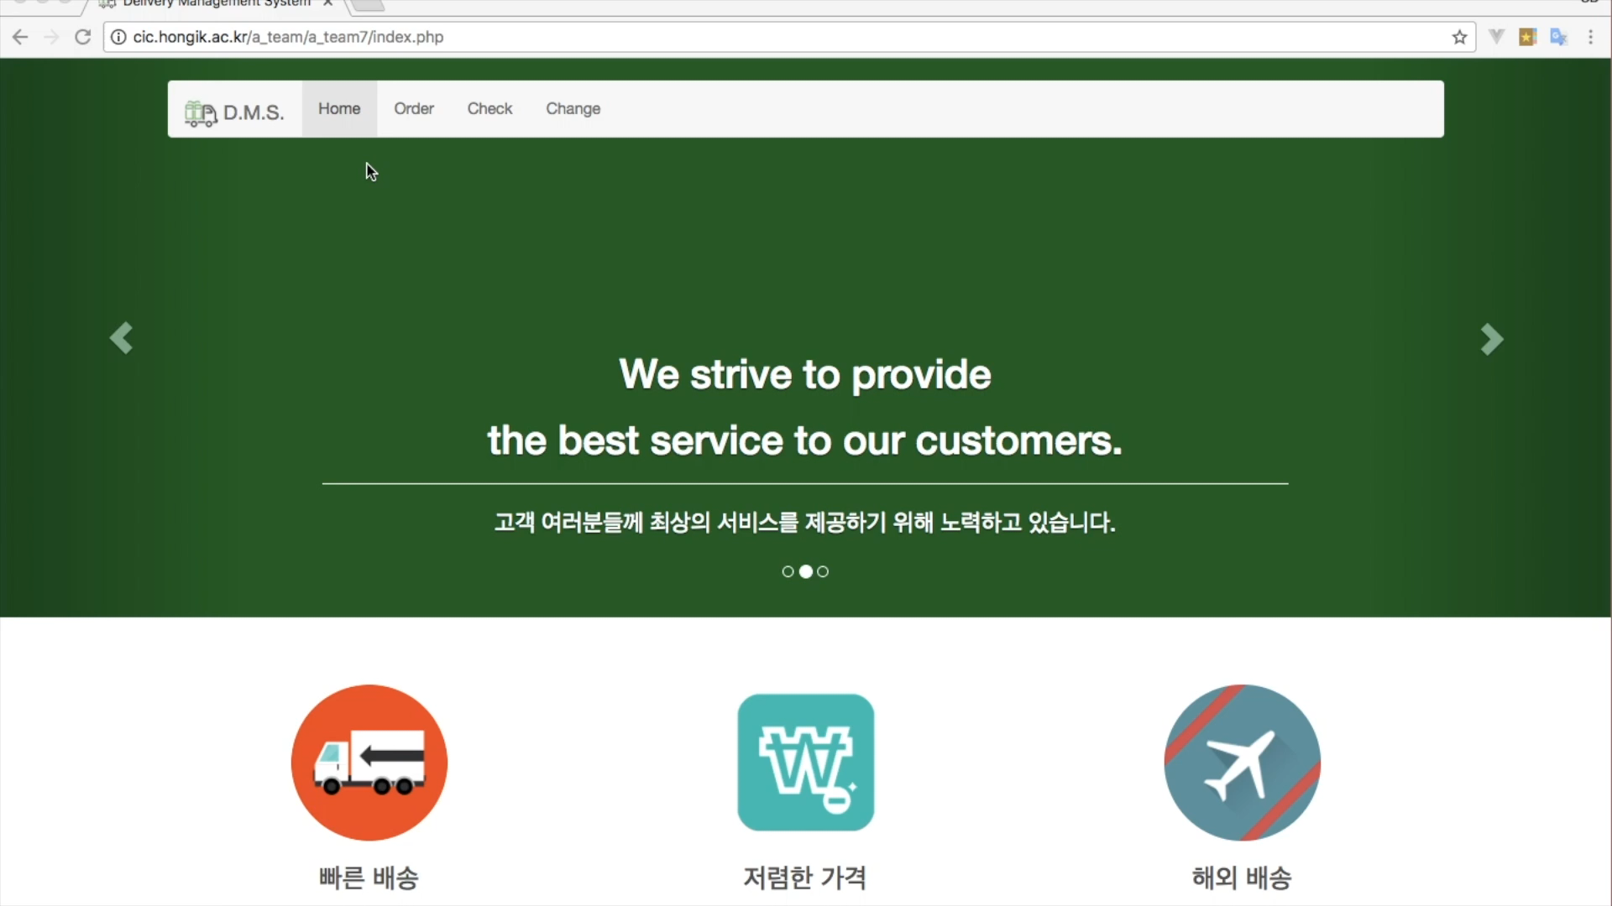
8
SIMULATION VIDEO

Slide 15

9
CONCULUSION
누구나
원하는 제품을
원하는 장소로 배송 받을 수 있다!

Slide 16
Q&A

Slide 17
THANK YOU

